Slide 1




What is new in C# 6.0 and 7.0
How does C# evolve as a language?
C#
Nikolay Kostov
http://nikolay.it
Software University
http://softuni.bg

Slide 2
About me
Nikolay Kostov
13 years of development experience (20 with overtime ☺)
Microsoft Certified Trainer with more than 15 exams taken
Worked in Telerik as a Manager, Software Engineering and as a part of the Telerik Academy with more than 400 videos in YouTube
Currently working at ZenCodeo as a Solutions Architect
How to find me:
Blog: http://nikolay.it/
GitHub: https://github.com/NikolayIT
Facebook: https://www.facebook.com/Nikolay.IT

Slide 3

Table of Contents
History of the C# Language
What's new in C# 6.0?
Roslyn, String Interpolation, Exception Filters, ?.
nameof, Expression Bodies, using static, etc.
What's new in C# 7.0?
TODO
TODO
What are the ideas for C# 7.1?

Slide 4
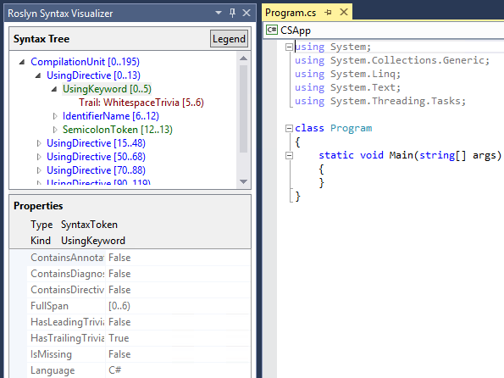
Used Software and Tools
Visual Studio 2017
.NET Compiler Platform SDK: link
ILSpy for decompiling the code
http://ilspy.net/
The official repo for the design of the C# programming language
https://github.com/dotnet/csharplang
Demo code available in GitHub:
https://github.com/NikolayIT/CSharp-New-Features
Documentation and Roslyn source code
https://github.com/dotnet/roslyn

Slide 5
History of the C# Language
VS 2002 .NET 1.0
https://github.com/dotnet/csharplang/blob/master/Language-Version-History.md
C# 1.0
Managed Code
C# 2.0
VS 2005 .NET 2.0
Generics <T>
Reflection
Anonymous Methods
Partial Types
Nullable Types
C# 3.0
VS 2008 .NET 3.5
Lambda Expression
LINQ
Anonymous Types
Extension Methods
Implicit Type (var)
C# 4.0
VS 2010 .NET 4.0
dynamic
Named Arguments
Optional Parameters
More COM Support
C# 5.0
VS 2012 .NET 4.5
Async / Await
Caller Information
C# 6.0
VS 2015
.NET 4.6
.NET Compiler Platform (Roslyn)
A lot of new features – mainly syntactic sugar
C# 7.0
VS 2017 .NET 4.7
A lot of new features
C# 7.1
VS 2017 Update 3
5 planned features

Slide 6

C# 6.0
Roslyn – The .NET Compiler Platform
Auto-property Enhancements
Expression Bodied Function Members
Using Static
nameof Operator
String Interpolation
Exception Filters
Null-conditional Operators
Dictionary Initializer
Await in catch/finally Blocks

Slide 7
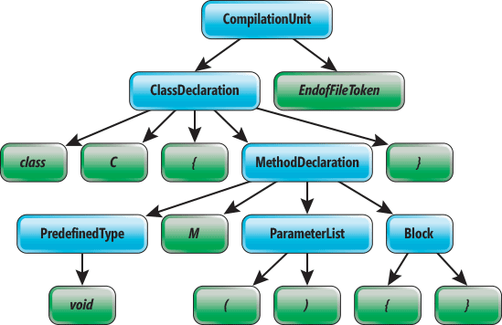
Roslyn
The .NET Compiler Platform

Slide 8
Roslyn – The .NET Compiler Platform
The compiler has been a black box before C# 6.0
Microsoft decided to re-write the compiler
Compiler for C# written in C#, compiler for VB.NET – in VB.NET
Open source: https://github.com/dotnet/roslyn
Easier to extend and maintain
Roslyn exposes modules (API) for syntactic (lexical) analysis of code, semantic analysis, dynamic compilation to CIL and more
Example for "Prefix local calls with 'this'": rule – link, fix – link
Video with more details (in Bulgarian): youtu.be/EXB5Izkkf44

Slide 9

Auto-property Enhancements

Slide 10
Auto Property Initializers
You can add an initializer to an auto-property, just as you can to a field:
The constructor directly initializes the backing field
Just like field initializers, auto-property initializers cannot reference "this"
public class Person
{
public string FirstName { get; set; } = "Nikolay";
public string LastName { get; set; } = "Kostov";
}
this.<FirstName>k__BackingField = "Nikolay";

Slide 11
Default Values for Getter-only Properties
Auto-properties can now be declared without a setter:
The backing field of a getter-only auto-properties is implicitly declared as read-only and is initialized in the constructor:
It can be assigned to via property initializer
In future releases it will be possible to assign it in the declaring type's constructor body
public string FirstName { get; } = "Nikolay";
.field private initonly string '<FirstName>k__BackingField'

Slide 12

Expression Bodied Function Members
Lambda expressions can be declared with an expression body as well as a conventional function body consisting of a block

Slide 13
Expression as Method Body
Methods as well as user-defined operators and conversions can be given an expression body by use of the “lambda arrow”:
The effect is exactly the same as if the methods had had a block body with a single return statement
For void returning methods - expression following the arrow must be a statement
public object Clone() => new Point(this.X, this.Y);
public static Complex operator +(Complex a, Complex b) => a.Add(b);

Slide 14
Expression as Property Getter
Expression bodies can be used for writing getter-only properties and indexers where the body of the getter is given by the expression body
Note that there is no get keyword
It is implied by the use of the expression body syntax
public string Name => FirstName + " " + LastName;
public Person this[string name] =>
this.Children.FirstOrDefault(x => x.Name.Contains(name));

Slide 15

Using Static

Slide 16
Import of Static Type Members into Namespace
Allows specifying a static class in a using clause
All its accessible static members become available without qualification
using static System.Console;
using static System.Math;
class Program
{
static void Main()
{
WriteLine(Pow(2, 10));
}
}

Slide 17

nameof Operator

Slide 18
nameof() Operator
Occasionally you need to provide a string that names some program element
When throwing ArgumentNullException
When raising a PropertyChanged event in WPF
When selecting controller name or redirecting to action in MVC
nameof operator gives us compiler checks, easy navigation and is easy for renaming (refactoring)
if (x == null) throw new ArgumentNullException(nameof(x));
@Html.ActionLink("Sign up", nameof(UserController), "SignUp")

Slide 19

String Interpolation

Slide 20
String Interpolation
Template string that contains interpolated expressions and inserts values into a string with simple syntax
Replaced with string.Format() during compile-time
Can contains variables, simple and complex expressions, array accesses, method calls, etc.
Console.WriteLine($"Name = {name}, hours = {hours:hh}");
Console.WriteLine(string.Format("Name = {0}, hours = {1:hh}", name, hours));
Console.WriteLine($"{cores} core{(cores == 1 ? null : "s")}");

Slide 21

Exception Filters

Slide 22
Exception Filters
If the parenthesized expression evaluates to true, the catch block is run. Can be used to call a method before catch.
Implemented with a "filter" block in CIL
try {
person = new Person("Nikolay", null);
}
catch(ArgumentNullException e) when (e.ParamName == "firstName") {
Console.WriteLine("First name is null");
}
catch(ArgumentNullException e) when (e.ParamName == "lastName") {
Console.WriteLine("Last name is null");
}

Slide 23
Logging with Exception Filters
We can use exception filters for side effects (e.g. logging)
Exception filters are preferable to catching and rethrowing (they leave the stack unharmed)
You have access to the actual stack when the exception arises
try { ... }
catch (Exception ex) when (Log(ex)) { ... }
private static bool Log(Exception exception)
{
Console.WriteLine(exception.Message);
return false;
}

Slide 24
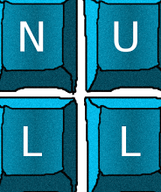
Null-conditional Operators
Null-propagating operator ?.

Slide 25
Null-conditional Operator
Lets you access members and elements only when the receiver is not-null
Providing a null result otherwise
Can be used together with the null coalescing operator ??:
Can also be chained
int? length = customers?.Length; // null if customers is null
Customer first = customers?[0]; // null if customers is null
int length = customers?.Length ?? 0; // 0 if customers is null
int? first = customers?[0].Orders?.Count();

Slide 26

Dictionary Initializer

Slide 27
Dictionary Initializer
A new syntax to object initializers allowing to set values to keys through the indexers
Before (C# 5.0)
Now (C# 6.0+)
var numbers = new Dictionary<int, string> {
{ 7, "seven" },
{ 13, "thirteen" }
};
var numbers = new Dictionary<int, string> { [7] = "seven", [13] = "thirteen" };

Slide 28

Await in catch/finally Blocks

Slide 29
Await in catch/finally Blocks
In C# 6.0 await is now allowed in catch and finally blocks
Implemented with IAsyncStateMachine and all logic is in the MoveNext method which uses TaskAwaiter to wait the threads
var input = new StreamReader(fileName);
var log = new StreamWriter(logFileName);
try {
var line = await input.ReadLineAsync();
}
catch (IOException ex) {
await log.WriteLineAsync(ex.ToString());
}
finally {
await log.FlushAsync();
}

Slide 30
C# 7.0
TODO

Slide 31

Declaration Expressions
Inline variable declarations.
Experimental feature. Currently suspended.
Dropped

Slide 32
Declaration Expressions
Declaration expressions allow you to declare local variables in the middle of an expression, with or without an initializer
The scope of the variables is to the nearest block or embedded statement (if-else)
if (int.TryParse(s, out int i)) { ... }
Console.WriteLine("Result: {0}", (var x = GetValue()) * x);
if ((string str = obj as string) != null) { ... str ... }
from s in strings select int.TryParse(s, out int i) ? i : -1;

Slide 33
Problem: Extract Unique Words
Write a JS function to extract all unique words from a text (case insensitive)
Words are sequences of letters, digits and _
The input comes as array of strings
The output should hold the words in their order of appearance
JS devs use Node.js for server-side JS.
JS devs use JS.
-- JS for devs --
js, devs, use, node, for, server, side

Slide 34
C# Code – How It Works?
Include the standard .NET namespace "System"
Define a class called "HelloCSharp"
using System;
class HelloCSharp
{
static void Main()
{
Console.WriteLine("Hello, C#");
}
}
Define the Main() method – the program entry point
Print a text on the console by calling the method "WriteLine" of the class "Console"

Slide 35
Basic Web Controls ⬄ HTML
ASP.NET Control | HTML Tag
<asp:checkbox> | <input type="checkbox">
<asp:hyperlink> | <a href="…"></a>
<asp:image> | <img src="…">
<asp:imagebutton> | <input type="image">
<asp:linkButton> | <a href="…"></a>
<asp:label> | <span>…</span>
<asp:listbox> | <select size="5"></select>
<asp:panel> | <div>…</div>
<asp:radiobutton> | <input type="radio">
<asp:table> | <table>…</table>
<asp:textbox> | <input type="text">

Slide 36

Summary
…
…
…

Slide 37








https://softuni.bg/courses/

Slide 38
License
This course (slides, examples, demos, videos, homework, etc.) is licensed under the "Creative Commons Attribution-NonCommercial-ShareAlike 4.0 International" license

Slide 39




Trainings @ Software University (SoftUni)
Software University – High-Quality Education, Profession and Job for Software Developers
softuni.bg
Software University Foundation
softuni.org
Software University @ Facebook
facebook.com/SoftwareUniversity
Software University Forums
forum.softuni.bg

